Slide 1

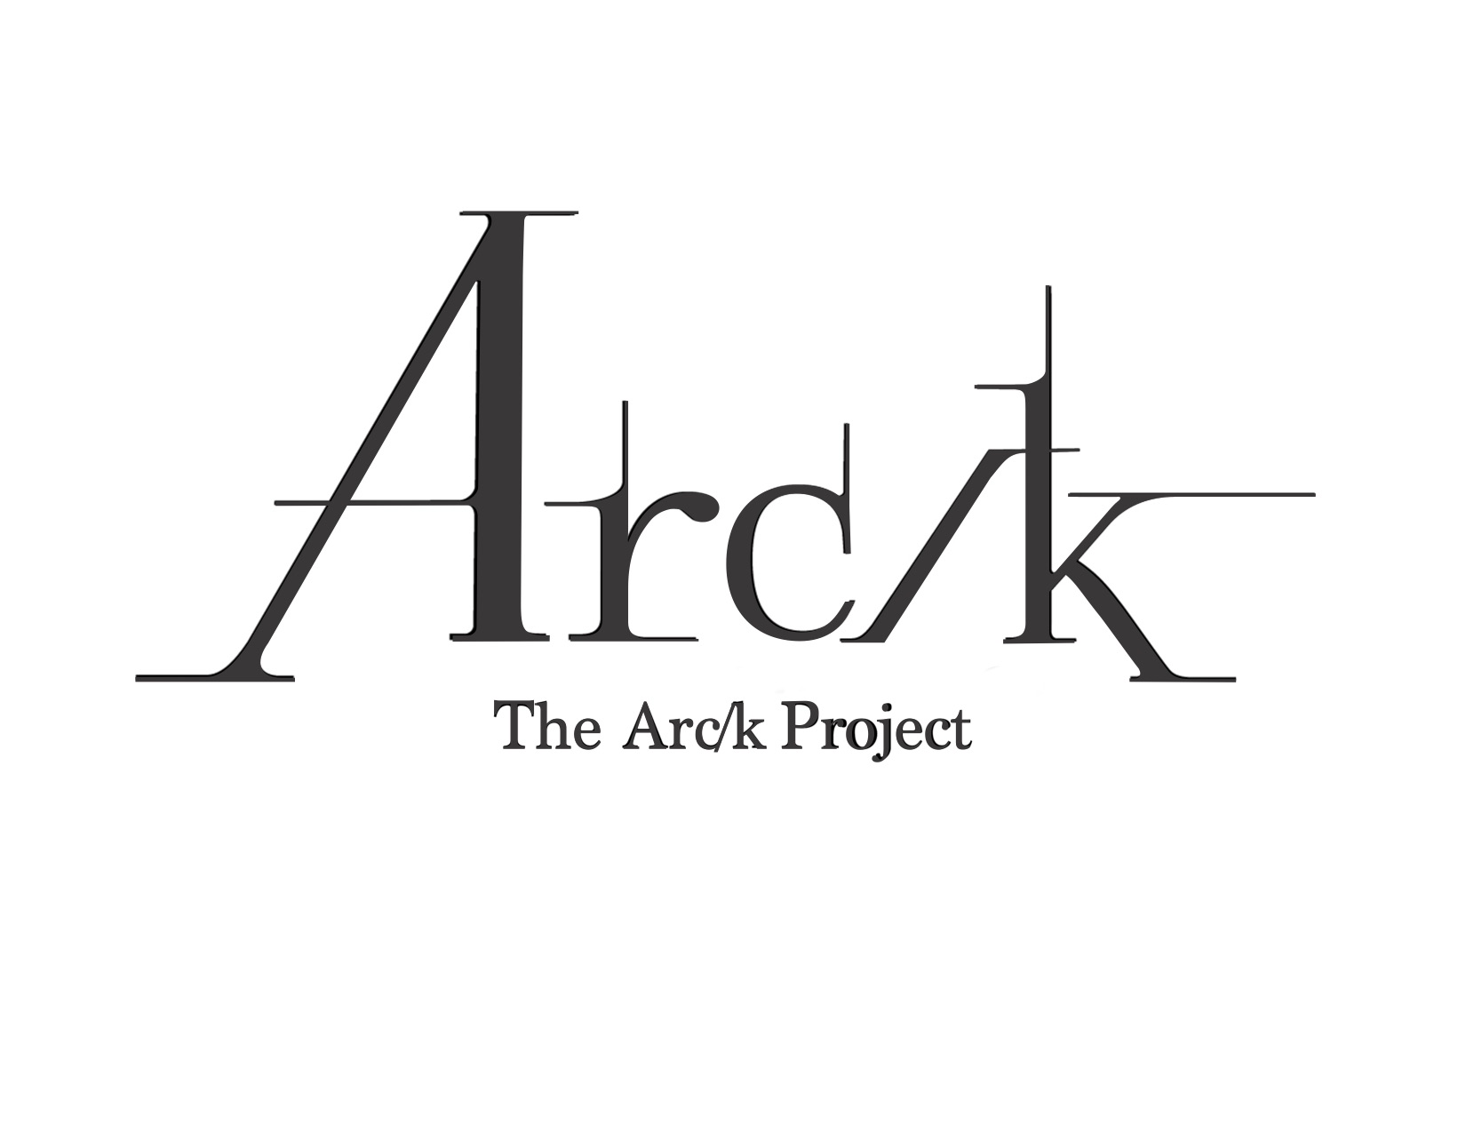
Conscientious Collaborations with Indigenous Communities
Acknowledging Colonial Practices and a Path Towards Respectful and Equitable Relationships
Michael Conyers, MLIS - Digital Archivist - The Arc/k Project
Notes:
Greetings, thank you for coming. This presentation is called Conscientious Collaborations with Indigenous Communities and I’m very happy to be here to share this with you all. First off, I’d like to let you know that this presentation today is being given from my perspective, as a non-tribal archivist who set out on a journey two years ago to learn about tribal perspectives, history and archival practices. This was originally related to my work with the Arc/k Project, a non-profit organization when we partnered with the Shuswap Nation in Kamloops BC to create digitized 3D images and VR of their museum’s cultural heritage objects and a location. As I learned about partnerships with Indigenous communities, I found an incredible number of resources at my disposal to help. Academic papers, guides like The Protocols for Native American Archival Materials, archival conferences like ATALM, AAM and of course SAA. There are also an abundance of Native American organizations and the tribes themselves that were quite helpful.
As I learned about the Native American experience and colonialist narratives, it became clear that colonial settlement in the Americas brought with it several practices that were used to control Indigenous peoples, with a goal to secure land and resources. The choices imposed by colonialist practices on Native peoples in most cases amounted to extermination or assimilation. As archivists today, we may not personally responsible for the injustices of the past, but we do have an ethical responsibility to recognize unjust colonial practices of the past and make positive changes to practices within our own domain.
A root concept that came about in my education was that Indigenous People are best speaking for themselves about their own stories and experiences. Today I will not be speaking for Indigenous peoples but will offer some practical recommendations that were compiled through my own education and experience in regards to how archivists like me could participate in equitable partnerships with Indigenous communities. We will hear the voices of Indigenous peoples and others through quotations before each set of recommendations, offering perspectives and mind-sets about colonial practices.

Slide 2
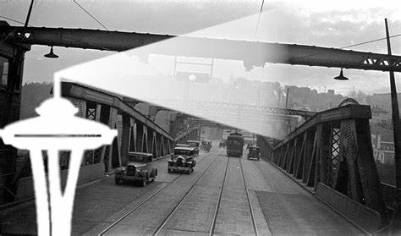

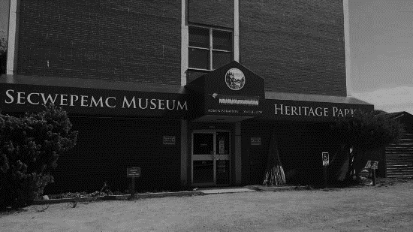
Education
Work
And More Education…
Seattle Area Archivists
This Photo by Unknown Author is licensed under CC BY-SA
Secwépemc Museum and Heritage Park
michael.conyers@arck-project.org
Notes:
A little bit about me… my name is Michael Conyers and I received a BA in History and an MLIS from the University of Washington in 2012 and 2014 after working with online catalogs for about 10 years. After graduation, I worked with digital images, taxonomy and controlled vocabularies. I found what I consider my dream job about 3 years ago, as I now work as the digital archivist for the Arc/k Project a non-profit organization preserving cultural heritage in a variety of innovative digital formats, for the most part 3D and VR. I have also been participating in the Community Standards for 3D Preservation Forum by contributing to a chapter on ethics and digitized cultural heritage. You’ll notice my third section on the timeline is “and more education” as I have steadily been educating myself about indigenous communities through experiences, partnerships and some great intellectual resources but am still learning every day about these subjects.

Slide 3
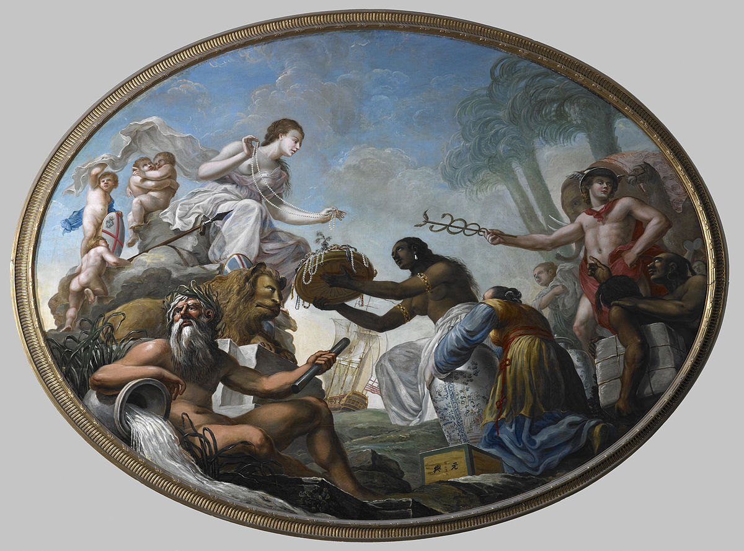
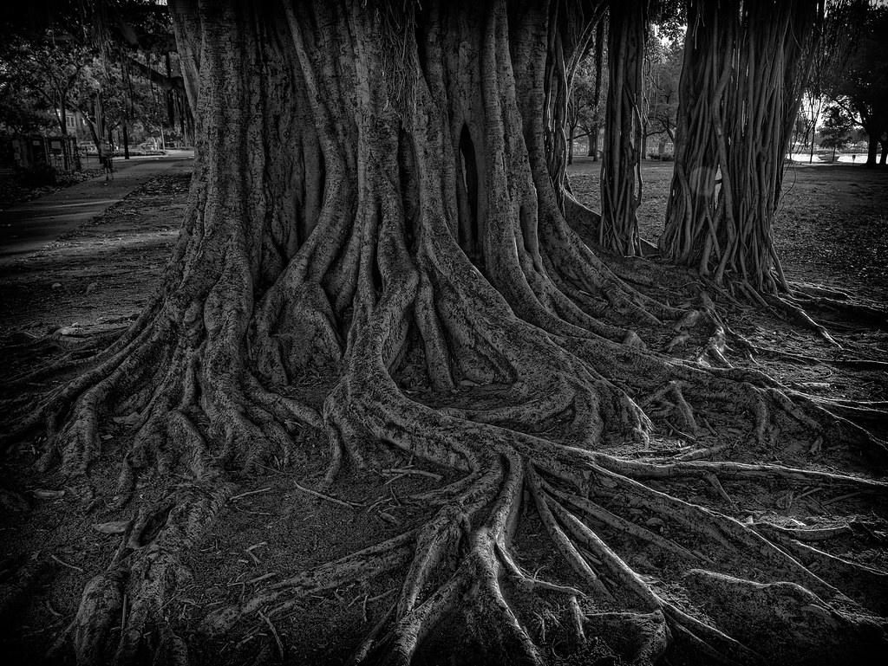
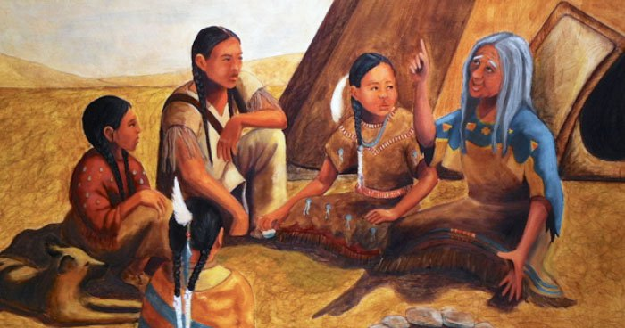
A Path Towards Equitable Partnerships
Recognizing Settler Colonialist Practices
Partnerships Based on Equitable Knowledge Sharing and Accommodations
Understanding Indigenous Ways of Knowledge and Experiences
This Photo by Unknown Author is licensed under CC BY-SA
This Photo by Unknown Author is licensed under CC BY-SA-NC
This Photo by Unknown Author is licensed under CC BY-NC-ND
Notes:
Learning about how one might ethically work with Indigenous community archives, it became clear how fundamentally different Indigenous ways of knowledge and ownership are from than euro-centric western ideas. They are really apples and oranges, and have lead to misunderstandings in many domains, not only archives.
As I’m sure with many of us here, my favorite aspect of archiving is that there is an opportunity to deeply understand the background and history of whatever subject I am archiving. It’s interesting as I love history in general, but practically I can create a plan that best serves who I am partnering with and apply archival standards and practices appropriately. It’s the same method when working with Indigenous communities, it is up to us to understand our partner from their perspective, their history and their experiences if we want to archive their materials properly. In so many cases of the past, Indigenous peoples interaction with Western knowledge and culture was through settler colonialist practices which disregarded and discredited indigenous ways of knowledge in a bid to control and exploit the population. In the Americas, this is 400 years of history, much of it recent and some even today. If non-tribal archivists can recognize historical colonial practices and tactics, listen and educate to understand Indigenous ways of knowledge it can form a basis of partnerships based on mutual and equitable knowledge sharing and accommodating, breaking recurring cycles of misunderstandings.

Slide 4
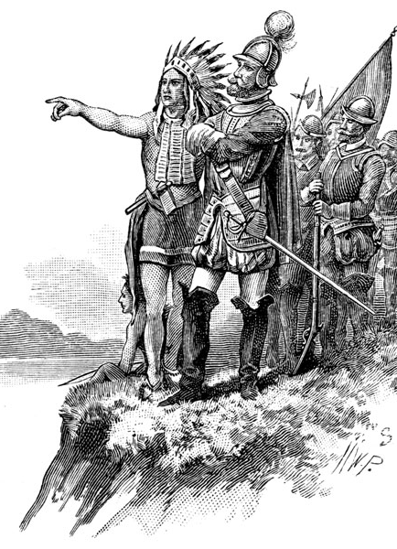




Recognizing History
A Short Selection of Colonial Practices
Marginalizing Indigenous Ways of Knowledge
The Imaginary Indian
Myths and Preconceptions
The illusion of cultural superiority through knowledge monopolies
Invalidating Sovereignty
Narrative Creation
Control through dependency and cultural assimilation
Storytelling and the use of vocabulary and description
Source: Montgomery, D. H. The Beginner's American History. Boston: Ginn and Company, 1902
Notes:
We are all probably familiar with the term colonialism, which is a 20th century word, but it describes processes that reach back millennia – Phoenicians, Greeks, and Saxons were examples of cultures that set up settler colonies and populated the lands with immigrants and set up governments that were not of the Indigenous peoples. Modern era colonialism by Europeans occurred all over the world on many continents, including the Americas. I won’t have time to discuss all of the reasons behind colonialism but I’ll have to suffice it to say that settler colonization in the Americas involved war, violent subjugation and displacement or in some cases outright extermination of native peoples and communities.
To help achieve this, a variety of unethical practices were used by settler colonialists, and we can still see the legacies today if we recognize history from alternate viewpoints and experiences. Today I would like to share with you a short selection of these practices and suggest ways, we as archivists can broaden our learning of Indigenous ways of knowledge and communication, opening the door to truly collaborative partnerships with Indigenous communities.
Although there are many colonial practices that negatively impacted the Indigenous peoples in colonies, we will focus on four –
The Imaginary Indian, how settler colonialists create stereotypical personas and myths about Indigenous peoples that serve their interests
Marginalizing Indigenous Ways of Knowledge – how colonialists impose their own ways of knowledge, ownership and laws while disregarding Indigenous knowledge as savage and uncivilized to create a myth of cultural superiority
Invalidating Sovereignty – By the suppression of Indigenous culture, forced relocations and denigrating local leadership, colonists attempt to make the local populations dependent solely on the colonial government
Narrative Creation – The colonialist use of vocabulary, description and storytelling to create a unilateral history from the colonialist viewpoint

Slide 5
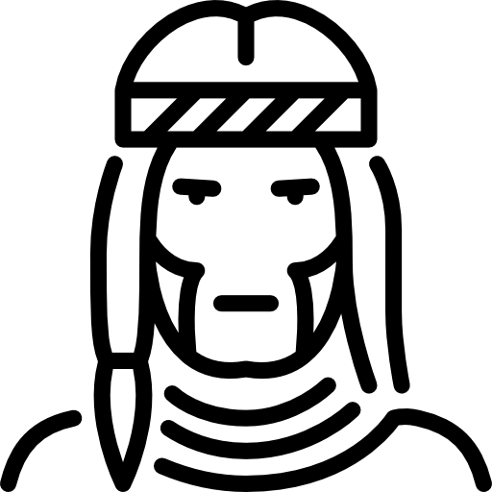

The Imaginary Indian
“A significant number of people believe tribal people still live and dress as they did 300 years ago. During my tenure as principal chief of the Cherokee Nation, national news agencies requesting interviews sometimes asked if they could film a tribal dance or if I would wear traditional tribal clothing for the interview. I doubt they asked the president of the United States to dress like a pilgrim for an interview.”
― Wilma Mankiller
"Non-Native[s]...can hardly hope to work out a successful relationship with Native people who exist largely in fantasy."
― Daniel Francis, The Imaginary Indian
Colonial Narratives and Stereotypes
Notes:
Read Quotes
Native American Tribes and cultures are not relics of the past to be preserved, but in fact are sovereign nations that yes have a past, but also have a living present and future. Many Native American symbols and images used by advertisers, film-makers and politicians are based on stereotypes of this “imaginary Indian” that through time has been depicted as a savage blood thirsty warrior, an environmentalist, wise elder, provider of healthy organic foods and soaps – whatever is needed to get the public to buy what they are selling.
Commercialization frames these characterizations as “ancient” or “relics of the past.” This notion denies the very existence of traditional Native American beliefs as valid ways of life today. Instead of accepting Native American lifestyles and culture as it is today, it is trivialized. Unwittingly notions of the “imaginary Indian” can not only lead to bias in archival practices such as vocabulary and description but can take away the opportunity to truly discover and understand the communities we seek to partner with.
The idea that Native American culture is only a thing of the past and that the people themselves were a “vanishing race” justified colonialist actions such as the removal of cultural heritage objects for safe keeping and scientific study by western institutions. This story also helped shape government policies of cultural assimilation to save them from extinction. This was confirmed through white artists and photographers around the turn of the 19th and 20th centuries as Native Americans were often depicted to show the Indian white people wanted to see – indigenous peoples as archaic vestiges of the past and enemies of progress.
With this in mind, we will consider at our first examples of colonial practices and suggestions for new practices.

Slide 6


The Imaginary Indian
Cutting through Myths and Commercialism
Past Practices
Suggested Practices
Non-tribal entities create and describe images of Native Americans
Save the artifacts of the “Vanishing Race” before Indians are extinct as a people
Branding Indian cultural heritage for commercial purposes
Native Americans control how they are depicted, telling their own stories
Acknowledge a growing population and contemporary realities
Avoid inappropriate commercialization by consulting with the culturally related Indigenous communities
Notes:
Past Practice
Images and collections of Native Americans are based on what colonialists want and envision Native Americans to be, rather than as they truly are
Suggested
Partner with Tribes to organize collections that include images and contexts that features Native Americans as they choose to be depicted, telling their own stories in their own ways
Past Practice
Archiving for the sake of saving the remnants of the “Vanishing Race.” A mentalitiy that we must save what is left before they die all off. There are no more real Indians.
The Truth
Native Americans have been here since time immemorial are still very present and alive, despite forced relocation, disease and genocide. There are 570 federally recognized tribes in the United States alone. The 2016 Census reported 6.7 million people in the United States identified as Indigenous with 27% speaking a Native language at home. If trends continue the Census estimates there will be 10.2 million Native people in 2060. We can break mythological stereotypes of the “Vanishing Race” by acknowledging contemporary realities - that Native American populations are growing and they can preserve their own past in their own way
Past Practice
Commercialism uses Native American branding to sell products as ancient, wild, exotic. Lifestyles are trivialized rather than accepted
Recommended
Recognize the goal of commercialism is to sell a product. By depicting Native Americans and their lifestyles as relics of the past, they are showing their customers what they want to see – the Imaginary Indian. As archivists, we can avoid inappropriate branding by consulting with the culturally related Indigenous communities so they can determine how cultural heritage should be depicted (if at all).

Slide 7


Marginalizing Different Ways of Knowledge
Meeker was possessed of a missionary fervor and sincerely believed that it was his duty as a member of a superior race to “elevate and enlighten” the Utes. As he phrased it, he was determined to bring them out of savagery through the pastoral stage to the barbaric, and finally to “the enlightened, scientific, and religious stage.” Meeker was confident he could accomplish all this in “five, ten, or twenty years.”
- Said of Nathan C. Meeker, Utes Reservation Agent, 1878
I see a time of Seven Generations when all the colors of mankind will gather under the Sacred Tree of Life and the whole Earth will become one circle again.
In that day, there will be those among the Lakota who will carry knowledge and understanding of unity among all living things and the young white ones will come to those of my people and ask for this wisdom.
- Crazy Horse, Oglala Lakota Sioux
Imposing Knowledge vs Knowledge Sharing
Notes:
Read Quotes
These two quotes are an example of very different mindsets about ways of knowledge and how knowledge is shared. The colonialist seeks to impose Western knowledge on a savage peoples who have not yet reached barbarity. Meeker seems to think that the Indigenous population needs to advance into the enlightened “stage”. He could very well have been referring to the Enlightenment era which was a euro-centric revolutionary act against the suppression of knowledge by the church and monarchies – which is ironic because with his imposition of enlightenment he seemed to ignore and suppress Indigenous knowledge.
On the contrary, Crazy Horse talks of the Lakota carrying or keeping their own knowledge about the unity of all living things, and at some point the white young people will ask for this wisdom. Unlike Meeker, there is nothing in Crazy Horse’s statement that denigrates western knowledge, or says that western knowledge and culture must be wiped out for his people’s knowledge to be relevant. There is no superior or inferior. In Crazy Horse’s statement there is an undertone that ways of knowledge can come together and be shared amongst cultures. Meeker and Crazy Horse certainly have different ways of knowledge..
So why was it so important for colonialists to impose western knowledge, communication, laws and religion upon Indigenous peoples? Note that according to colonialists western knowledge is billed as “advanced” and “civilized.” A definition of civilized is “easy to manage or control”. By that definition, colonialists who seek to “civilize” indigenous populations are actually trying to control them. In simple terms, colonialism uses the imposition of their ways of knowledge and culture as a tool control Indigenous peoples.

Slide 8
Marginalizing Indigenous Ways of Knowledge
Imposing Knowledge vs Sharing Knowledge
Past Practices
Suggested Practices
Colonists ways of knowledge, communication, laws and religion are are imposed on Native peoples to “civilize” them
Indigenous knowledge and artifacts are openly discussed and disseminated without consultation
Native cultural heritage can be “owned” and copyrighted by collecting institutions and individuals
Indigenous knowledge is as just as valid as knowledge archivists bring to partnerships.
Indigenous access protocols can conflict with public domain initiatives and open access to materials. Honor cultural privacy and secrecy
Seek to understand the core philosophical differences between Indigenous and Euro-centrive views on ownership.
Notes:
Past Practice
The imposition of western knowledge - Although Indigenous ways of knowledge and communication are often fundamentally different than Western versions, it just makes them different – not wrong, inferior or invalid. As archivists, we can sometimes unconsciously seek to control the archiving of materials through a strict imposition of standards and practices when working in partnerships. Only when knowledge is mutually shared, understood and respected, can it become clear how both partners can be properly accommodated. Consider altering archival practices to suit the partnership rather than the standard. Another consideration is to include “bridge people” who understand both Indigenous knowledge and archival practices
Next point
Indigenous knowledge and artifacts are openly discussed and disseminated without consultation with the culturally affiliated tribe. This as a service to the academic and scientific communities, thus fulfilling institutional missions
Recommended
Indigenous culture’s protocols that give access to knowledge are often fundamentally different than Western customs. Progressive Euro-centric concepts such as public domain and open access do not fit the complex rules for the governing of access to and use of Indigenous communities’ knowledge and resources. Consider integrating the use of Traditional Knowledge labels into your partnerships from localcontexts.org to provide communities with a variety of culturally relevant access protocols
Past Practice
Cultural heritage objects and locations are owned and even copyrighted by non-tribal individuals, organizations and institutions. In some cases, culturally related communities are not allowed access to materials
Recommended
There are core philosophical differences between western and Indigenous thought on ownership. Understanding the root cause of the differences is important and I’d like to take a much too quick look at Indigenous knowledge and Western Intellectual Property systems, because they are really apples and oranges.

Slide 9




Indigenous Knowledge and Western IP Systems
Traditional Knowledge
Public Domain
Intellectual Property
Complex Systems of Regulating the Use of Knowledge
The Use of Knowledge in a Free and Unconstrained Manner
Individual Property Based Model
Notes:
Indigenous Knowledge and Western IP
I wish I had more time as these are important concepts to understand but with the time I have I’ll briefly comment on the fundamental philosophical difference between western and indigenous concepts about ownership and property. The document I rely on to understand this is the Statement by the Tulalip Tribes of Washington on Folklore, Indigenous Knowledge, and the Public Domain which was presented to the World International Property Organization in 2004 and I’d encourage you to seek it out and read it yourself.
At its very core, Indigenous ways of ownership are based on the idea that knowledge and resources are gifts from the creator, not to be owned by any one person or entity. This is philosophically very different than western property law which is the descendant of enlightenment era thinkers like John Locke who are taking back property and knowledge monopolies from monarchies. As western ideas about the sharing of knowledge continues to loosen we are at a point where public domain sharing is encouraged as a moral act.
For Indigenous peoples, they did not go through the same cultural experiences as Europe. Openly sharing knowledge is not a revolutionary act to ensure freedom and independence as it is for European cultures, knowledge is often sacred and the people who hold it are seen as caretakers and stewards, not owners and not derived from a past culture of unwanted and forced knowledge suppression.
There is much more to this, and I encourage you to educate yourself on these concepts, but we must move on to Invalidating Sovereignty

Slide 10


Invalidating Sovereignty
You are on an Indian reservation merely at the sufferance of the government. You are fed by the government, clothed by the government, your children are educated by the government, and all you have and are today is because of the government. If it were not for the government, you would be freezing and starving today in the mountains.
...the government feeds and clothes and educates your children now, and desires to teach you to become farmers, and to civilize you, and make you as white men.
- John A. Logan, United States Senator to Sitting Bull at the Dawes Commission Meeting, 1883
American Indians maintained self-government in diverse social and cultural forms from time immemorial. For most Indigenous nations, sovereignty or self-government was given by the creator at creation. Thereby no other earthly body (including the United States) has the right to take sovereignty and territory away from Indigenous nations.
- Dr. Duane Champagne, Chippewa, Professor of Sociology and American Indian Studies UCLA
Control through forced dependency and cultural assimilation
Notes:
Invalidating Sovereignty
These are two different viewpoints that harken back to the concepts we just discussed about ownership. For settler colonialists to govern, it must end the true sovereignty of the Indigenous communities. As civilizing a community by imposing colonialist knowledge and culture fed colonialist control, so too does the invalidation of indigenous sovereignty.
Without sovereignty, native communities were forced to change their ways of life fundamentally by being removed from their traditional lands and food gathering areas. This led the isolated native population into a life of forced dependence on the colonial government and that terms could be dictated to tribes rather than negotiated. Tribal sovereignty is a struggle in the Americas even today in the courts as government laws clash with Indigenous ways of life and resources.

Slide 11
Invalidating Sovereignty
Control through dependency and cultural assimilation
Past Practices
Suggested Practices
Indigenous peoples must fight for recognition and compel the colonial government to live up to its treaty obligations
Tribes do not have rights or even access to some cultural heritage objects and locations
Land and resources are confiscated to keep the Indigenous population dependent on the colonial government for sustenance
As archivists, in our partnerships we can offer memorandums of agreements and collection policies in clear language, honoring them
Consider repatriation of cultural heritage objects and documents beyond NAGPRA requirements whenever possible
Equitable partnerships are balanced with shared responsibilities, not dependency
Sources: Partnership with Native Americans Organization
Notes:
Past
Many treaties Indigenous peoples made with the colonists were made under duress, in a manner dictated by the conqueror to the conquered. After they were signed, treaties were changed as colonial governments saw fit to take more land, resources and autonomy away from tribes. Tribes must fight for recognition and to compel the United States to live up to its treaty obligations
Recommended
As archivists, we have an opportunity to validate tribal sovereignty when jointly creating and honoring contracts and memorandums of agreements directly with tribes. Furthermore, creating a collection policy stating how your organization intends to ethically partner with and manage Indigenous archival materials in clear language is a good starting point for dialog
Past
After centuries of conflict, relocation, removal and assimilation, many Native American tribes no longer have rights to natural resources in their original homelands and to culturally affiliated artifacts
Recommended
As archivists, we can interpret this colonial practice as one that separates tribes from ownership, access and management of their culturally affiliated materials. Consider repatriation of cultural heritage objects beyond NAGPRA requirements whenever possible. Provide ownership and intellectual control to tribes for digitized and terrestrial culturally affiliated objects and locations. Envision policies that prioritizes tribal needs and protocols that lets them represent themselves in metadata and contextual description
Past practice
Reserved land, food and material goods are provided to keep the Indigenous population dependent on the colonial government
Suggested
Equitable partnerships are balanced with shared responsibilities, not dependency. Engage in mutual knowledge sharing to establish what resources are needed that would let Indigenous peoples decide the level of management they want over their collections. When requested, partner with tribes for grant funding that provides long term sustainability for their archives.

Slide 12


Narrative Creation
The whites told only one side. Told it to please themselves. Told much that is not true. Only his own best deeds, only the worst deeds of the Indians, has the white man told.
- Yellow Wolf of the Nez Perce (c.1855-1935
When a white army battles Indians and wins, it is called a great victory, but if they lose it is called a massacre.
- Cheeseekau, Shawnee (1760-1792)
There is not one Indian in the whole of this country who does not cringe in anguish and frustration because of these textbooks. There is not one Indian child who has not come home in shame and tears.
- Rupert Costo (1906-1989)
Creating stories that affirm and justify settler colonialism
Notes:
Storytelling has proved to be the most important communication tool that humans possess. It is used to provide cultures instructions on how to live and how not to live, what is “good” and “evil”, what to embrace, what to avoid and sometimes how fellow humans should be regarded and treated in kind.
In settler colonial practice, stories were used just as they always have been, to tell audiences right from wrong, good and evil, how others should be viewed and treated – and in this case it best from a single voice, the colonizers. This is where vocabulary was used to differentiate the civilized from the savage, justify the taking of lands and the assimilation through the “vanishing race” narrative. This is where the Imaginary Indian comes from.
Today, through us, stories are told via museum and archival collections, in their arrangements, context, description and vocabulary. If we choose not to partner with culturally affiliated Indigenous communities to allow them to tell their stories, in their way, using their vocabulary, access protocols and methods of communications that suit them, are we in some way continuing the colonialist narrative tradition even if we have the best intentions? It’s a question I’ll leave you with.

Slide 13
Narrative Creation
Storytelling and the use of language and vocabulary
Past Practices
Suggested Practices
Indigenous people’s ways of communication are “primitive”, “crude” and “undeveloped”
Naming, language and vocabulary are exercises in power
Biased vocabulary is used to promote colonialist narratives.
Support Indigenous people’s telling of their own stories in their own way.
Consult and use the tribe’s own names and languages as primary vocabulary
Recognize legacy biased vocabulary. It is up to us to promote change in our own systems
Notes:
So, with that said, here are a few recommendations
Colonial Practice
Written euro-centric communication is superior to Indigenous people’s ways of communication which are “primitive”, “rough”, “crude” and “undeveloped.”
Recommended Practice
On the contrary, Indigenous ways of communication are typically precise, unwavering, highly stylized and well disciplined. Some ways of communication include sand painting, movements, oral dialog and even silence. As archivists, when partnering with tribes and given permission, we should seek to record communication using media that best serves the tribe. Accept that in some cases, communication may not be able to be recorded as it requires person to person communication only. Support Indigenous people’s telling of their own stories in their own way.
Colonial Practice
Naming, language and vocabulary are exercises in power. Some Native American groups were tagged with names chosen arbitrarily by European settlers. In fact, they were often derogatory names other tribes used to describe their rivals. For example Comanche is derived from a word in Ute meaning “anyone who wants to fight me all the time”
Recommended Practice
When colonialist suppression of Indigenous languages retreats, languages can be revitalized, and these revitalization efforts are going on around the world. In many cases, rather than extinct, languages are endangered and need to be used again. Archivists can support revitalization in several ways. Written Indigenous languages can differ from anglicized pronunciations. Consider using tribal language when available as the prioritized language in titles and descriptions when advised to, using the anglicized version as an alternate title which is useful for search referencing and legacy information. Existing catalogs that need to be updated with Indigenous languages should not prioritize legacy data that uses anglicized vernacular.
Colonial Practice
Biased vocabulary is used to promote colonialist narratives. For example, as Cheeseekau said, white armies win victories, Indians battles are massacres.
Recommended Practice
Although biased terms can be helpful for the purpose of provenance and as reference for colonialist viewpoints, they are not appropriate for subject headings, classifications and primary terms in controlled vocabularies. Language is constantly evolving according to societal and ethical viewpoints and vocabulary must change with it. As archivists and librarians, we provide and interpret knowledge. It is up to us to promote ethical changes in our catalogs, standards and classification systems within our archival and library domains that are inclusive and recognize a colonial legacy of bias.

Slide 14
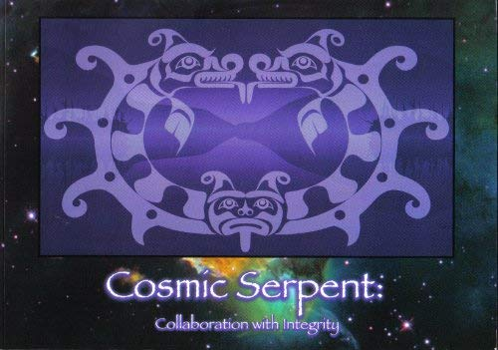
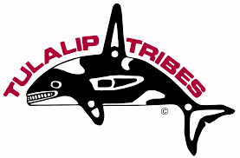
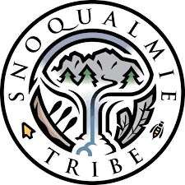
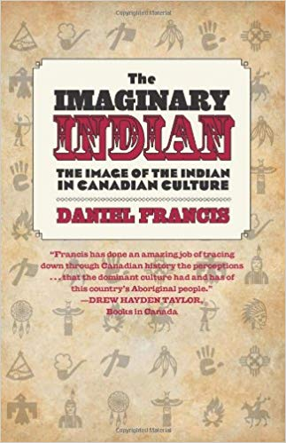
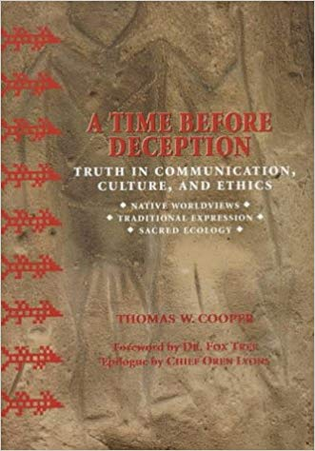
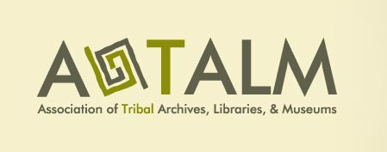
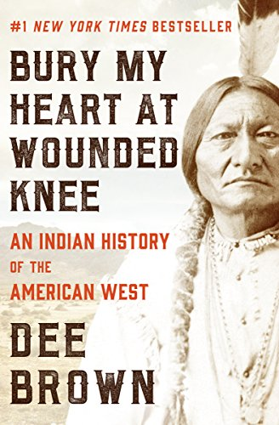
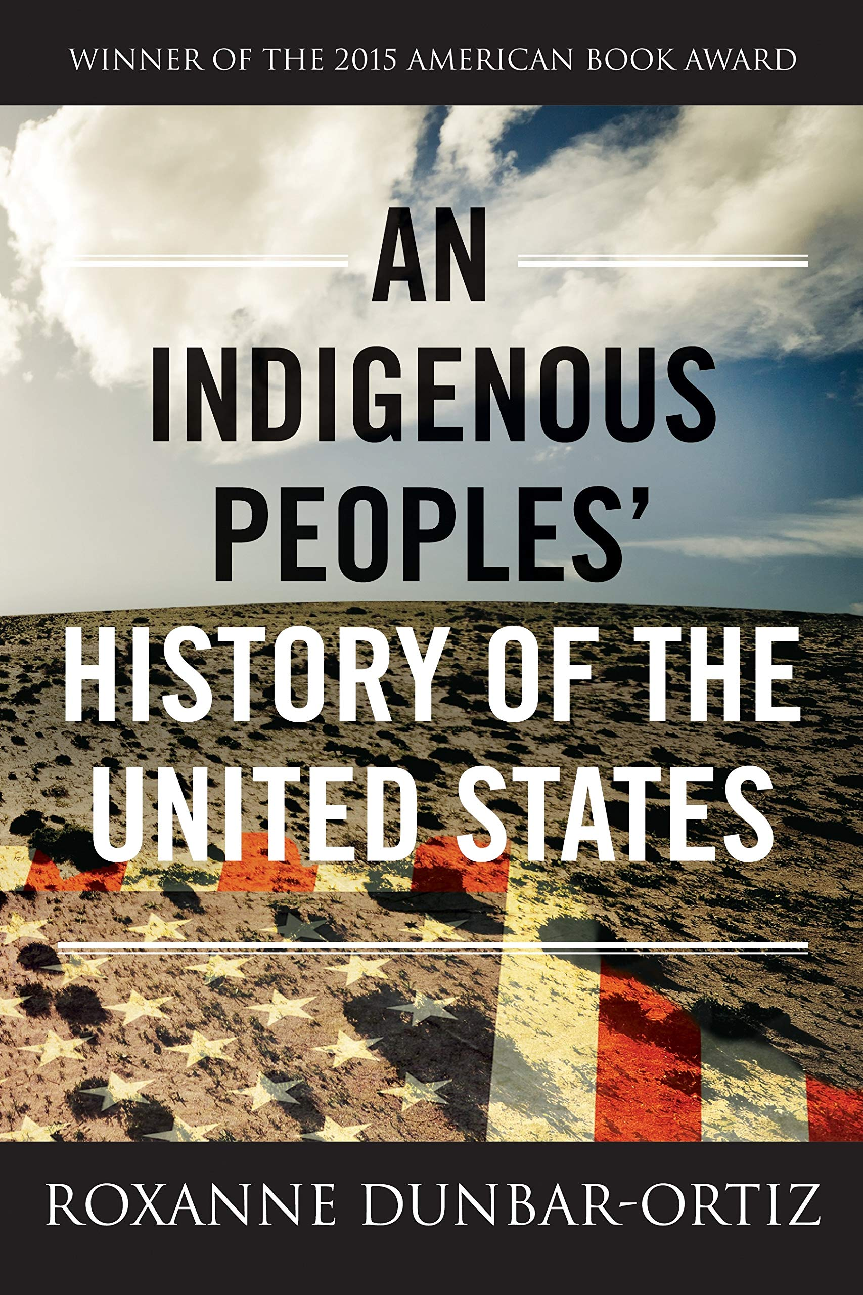
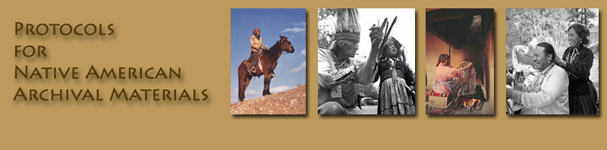
Influences and Resources
An Ongoing Journey
Notes:
With that I’d like to thank all the influences and resources that went into my thinking and this presentation, this is just a small sample of them. I’d encourage you to explore alternative histories by Indigenous peoples, native organizations, and conferences and committes that can share the thoughts and views of Indigenous peoples.

Slide 15
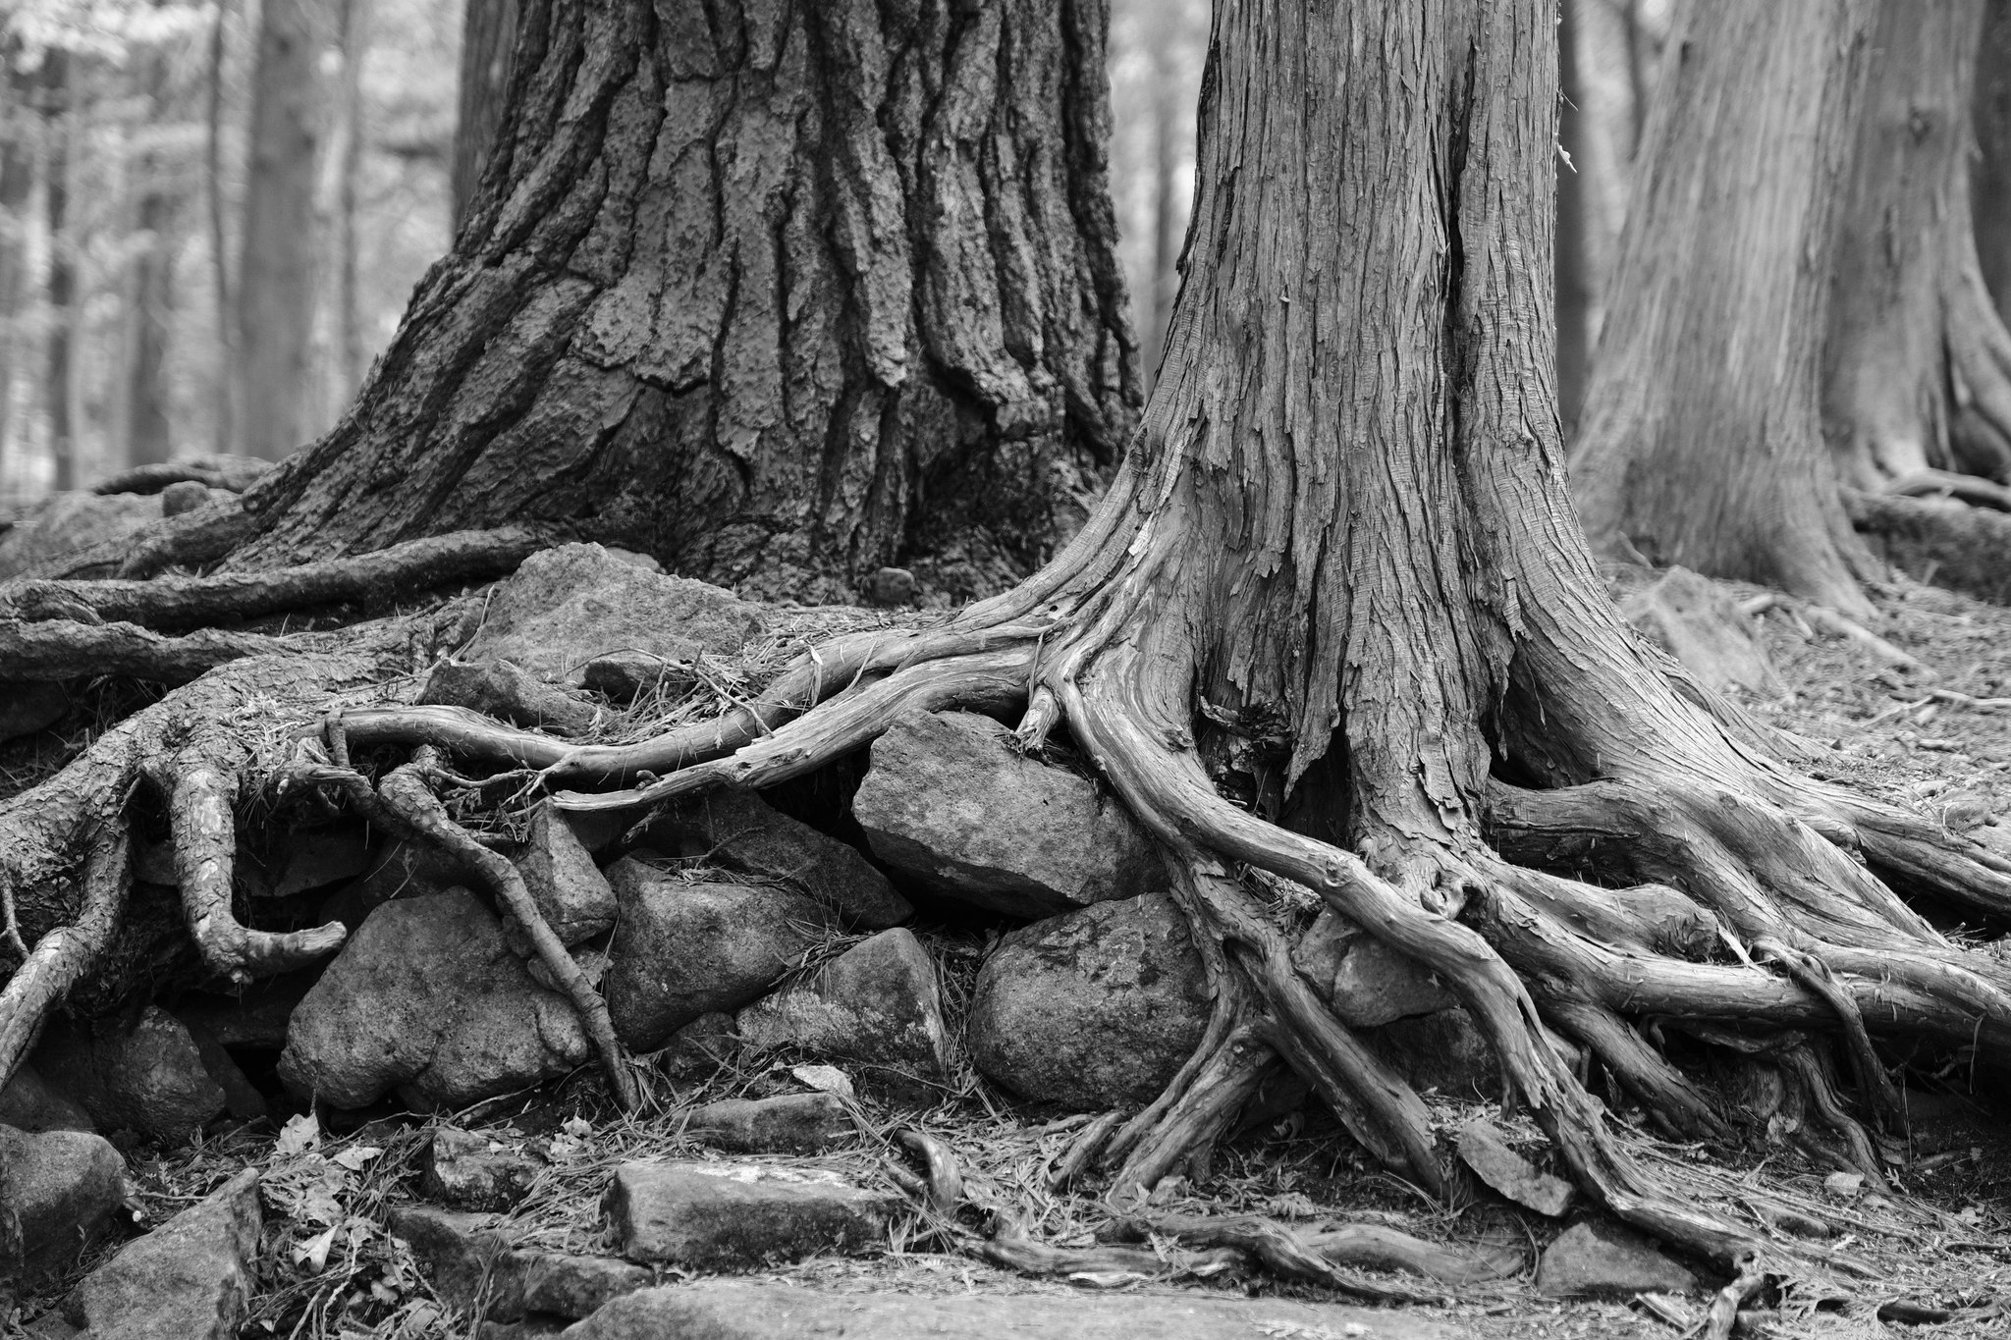





Thank You
I see a time of Seven Generations when all the colors of mankind will gather under the Sacred Tree of Life and the whole Earth will become one circle again.
In that day, there will be those among the Lakota who will carry knowledge and understanding of unity among all living things and the young white ones will come to those of my people and ask for this wisdom.
- Crazy Horse, Oglala Lakota Sioux
Michael Conyers, MLIS
The Arc/k Project
a 501(3)(c) Non-Profit Organization
Seattle, WA – Los Angeles, CA
michael.conyers@arck-project.org
https://collections.arck-project.org/
This Photo by Peter Balcerzak is licensed under CC BY-SA
Notes:
I’d like to leave you with the quote once again from Crazy Horse. He mentioned that in seven generations non-tribal people will be interested in Indigenous wisdom and I’d include ways of knowledge and ownership. These words were spoken in 1877 and if we consider each generation to be 20 years, we are that generation. It is my hope that all of us as archivists seek to try and fulfill Crazy Horse’s vision by consulting with indigenous communities when we work with their cultural heritage, seeking their wisdom and knowledge. If we recognize colonial practices and bias, listen to and understand native people's experiences and accommodate different ways of indigenous knowledge into our work, it is an important step towards equitable knowledge sharing and receiving the wisdom Crazy Horse’s people wished to share with us.
Thank you

